Slide 1
Updated Optimization Results
Angled ONN

Slide 2
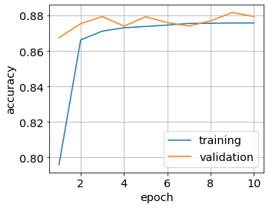
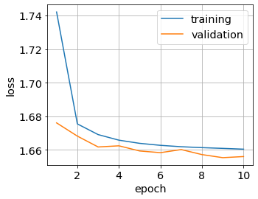
Bayesian Optimization Results 28x28 Neurons & 28x28 Neurons
10 Epochs, Batch Size 8
Validation and Training Accuracy ≈ 88%
parameter | value | decription
d1 [µm] | 18.31 | lateral size of the first metasurface
d2 [µm] | 21.76 | lateral size of the second metasurface
d3 [µm] | 22.27 | lateral size of the field we want to detect at the output plane (at z2)
z1 [µm] | 30.55 | the propagation distance inbetween both metasurfaces
z2 [µm] | 37.15 | propagation distance from the metasurface to the detector
* pixelsize for the metaatoms p = d/28

Slide 3
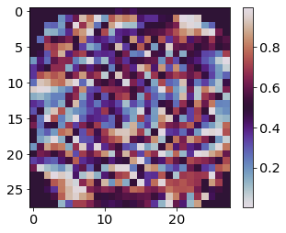
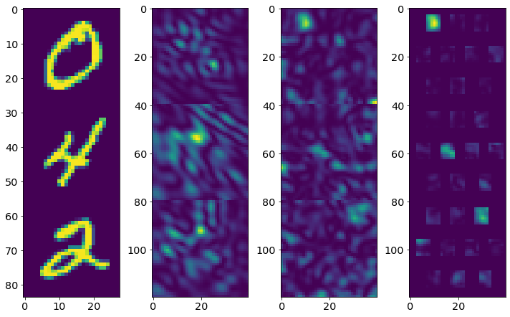
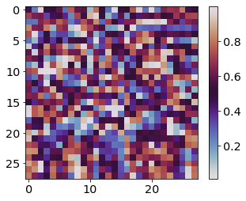
Sample Propagation
Phase Modulation Meta 1
[2π]
Right before
Meta 1
Right before
Meta 2
Right before
Detector
Detector & Mask
Phase Modulation Meta 2
[2π]
Validation and Training Accuracy ≈ 88%

Slide 4
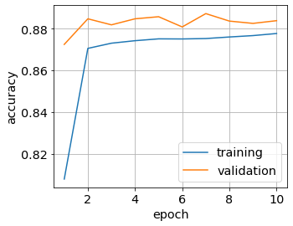
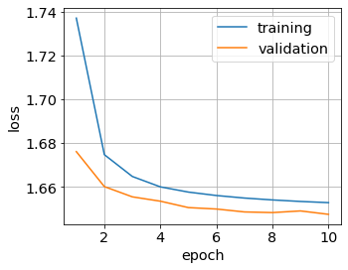
Bayesian Optimization Results 28x28 Neurons & 40x40 Neurons
10 Epochs, Batch Size 8
Validation and Training Accuracy ≈ 88%
parameter | value | decription
d1 [µm] | 19.44 | lateral size of the first metasurface
d2 [µm] | 21.43 | lateral size of the second metasurface
d3 [µm] | 22.93 | lateral size of the field we want to detect at the output plane (at z2)
z1 [µm] | 30.04 | the propagation distance inbetween both metasurfaces
z2 [µm] | 37.23 | propagation distance from the metasurface to the detector
* pixelsize for the metaatoms p = d/28

Slide 5
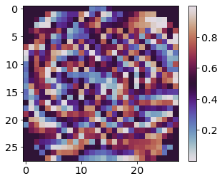
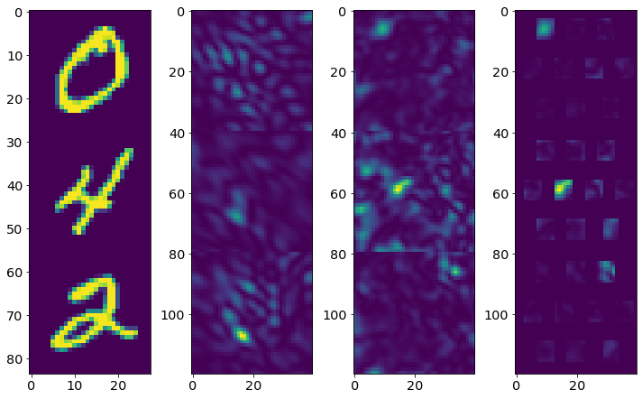
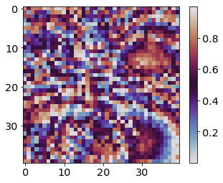
Sample Propagation
Phase Modulation Meta 1
[2π]
Right before
Meta 1
Right before
Meta 2
Right before
Detector
Detector & Mask
Phase Modulation Meta 2
[2π]
Validation and Training Accuracy ≈ 88%

